Slide 1

MEAN Stack Development
SDC 360 Web Application Development
Perry, Joseph
Snow, Joey
Toran, Aeon
June 17, 2025

Slide 2
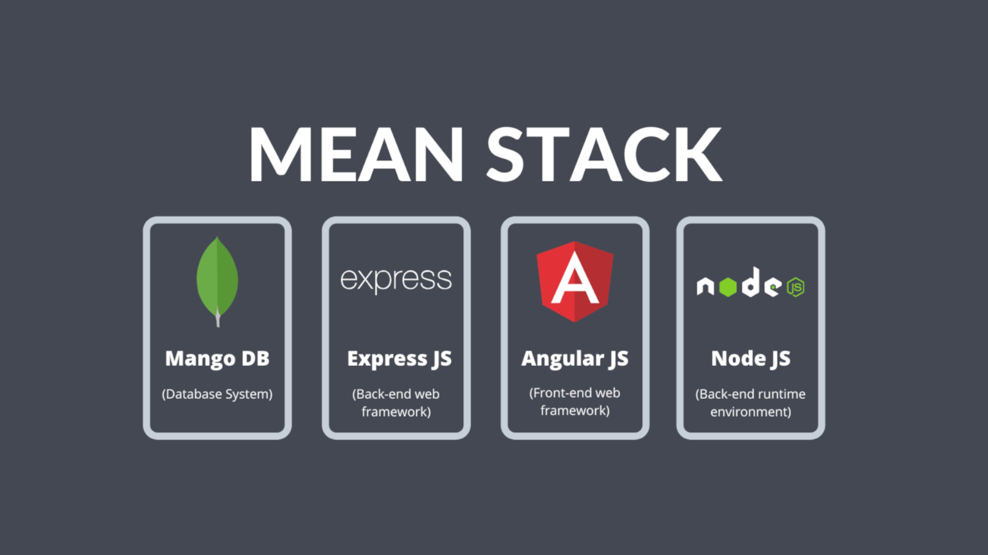
Introduction
The MEAN stack is a Java-script development framework for use in cloud applications. The acronym stands for:
MongoDB - object oriented database design(no SQL)
Express.js – Web App Framework for Node.js that supports interactions between the client side and the database.
Angular.js - Client-side framework to create dynamic web applications
Node.js - JavaScript web server used for scalable applications

Slide 3
What are the advantages and disadvantages of using the MEAN stack for Netflix?
The advantages that Netflix had using the Mean stack and particularly Node.js was that Node.js gave them Faster performance, it was Scalable, it Reduced developer complexity using JavaScript, and it had faster Deployment.
The disadvantages is that JavaScript was not made to build back-end servers.
Another disadvantage is that Netflix is now limited to using one programming language.

Slide 4
How does the MEAN stack contribute to the overall performance and user experience of Netflix?
Backend (Node.js + Express)
Handles asynchronous requests for streaming, user data and recommendations.
Frontend (Angular)
Enables fast, dynamic page updates (specifically useful for smart TVs and mobile devices.)
Database (MongoDB)
Stores content metadata, user preferences, and session data in flexible JSON format.

Slide 5
Based on your research, would you recommend using the MEAN stack for similar web applications like Netflix?
With over 100 million more subscribers than their leading competitor, Netflix has done something right.
Using the MEAN stack has allowed Netflix to optimize their performance, handle their huge customer base, as well as keep the application appealing to the eyes.
We would recommend other streaming services also use the MEAN stack.

Slide 6

Conclusion
MEAN is a JavaScript based Web Application Framework.
It can handle many users, process a lot of data, is rapidly deployable and can be visually appealing.
Whether it is the frontend, backend, or database, MEAN has a solution.
We do recommend other streaming services follow Netflix's lead with this framework.

Slide 7
References
MongoDB. (n.d.). MEAN stack. MongoDB. https://www.mongodb.com/resources/languages/mean-stack
Yu, I. (2024). The Tech Behind Netflix’s Unstoppable Streaming. Skiplevel.co. https://www.skiplevel.co/blog/tech-stack-behind-netflix-streaming-secrets
FlixPatrol. (2025). Streaming Services by Subscribers. FlixPatrol. https://flixpatrol.com/streaming-services/subscribers/ reddit.com+9flixpatrol.com+9flixpatrol.com+9
‌Supersourcing. (n.d.). Popular Use Cases of MEAN Stack Development. Supersourcing. https://supersourcing.com/blog/top-8-mean-stack-applications/

